Slide 1


HOTEL ANALYSIS
KADIRI OLUWAFADEJIMI SARAH
DATE: FEBRUARY 24, 2023

Slide 2
TABLE OF CONTENT
1. Introduction
2. Problem Statement
3. Methodology
4. Analysis 5. Insights 6. Recommendation

Slide 3
INTRODUCTION
CLIFE Resort is the owner of several five-star hotels in Nigeria. They've been in the hospitality business for 20 years and they looking to reclaim market share and income.

Slide 4
PROBLEM STATEMENT
CLIFE is losing market share and revenue in the luxury/business hotels sector as a result of strategic actions by competitors and ineffective decision-making by management. CLIFE's managing director desired to incorporate "Business and Data Intelligence" as a strategic step in order to reclaim market share and income.
TASK:
Create the metrics according to the metric list.
Create a dashboard according to the mock-up provided by stakeholders.

Slide 5
METHODOLOGY
Approach and Timeline
May 30, 2022
June 2, 2022
June 6, 2022
June 8, 2022
1
2
3
4
Data and Requirement Gathering
-Data collection
- Understanding the business problem
Data Cleaning
-Exploratory data analysis
-Data quality issues
Data Analysis
Visualization
Reports
Analysis

Slide 6
ANALYSIS
Data Collection.
Octave Data Team provided the data used for this analysis on the 20th February 2023. The data is a record of hotel properties and metrics for the period of 3 months being May to July 2022.
Data Cleaning.
The following actions were performed in the process of cleaning the data using Power query in Power Bi:
The empty cells were replaced from null to zero using replace values.
The date dataset was formatted properly and some measures were added. The revenue and other metric values were formatted to currency.
Visualization.
The clean data was imported to Microsoft Power BI, in order to build visualizations that Provide Insights to the revenue team .
The following insights were generated from our analysis:
Analysis on Hotel Cities based on the Revenue generated, Occupancy Rate and Average Ratings.
Analysis on Hotel Properties based on Key Metrics like Revenue, Average Ratings, Total Successful Bookings, and Occupancy Rate vs Cancellation Rate.
Occupancy Rate and Average Rating based on Week number.
Total Bookings by City.
Hotel Booking by Platform, Room Category and Day Type.

Slide 7
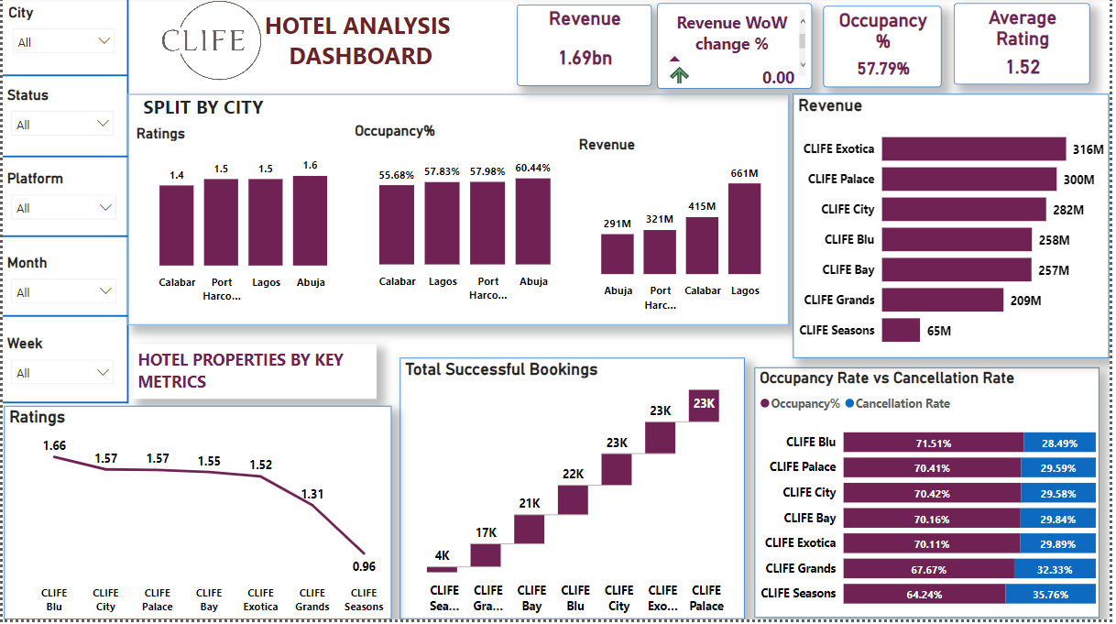
VISUALIZATION

Slide 8
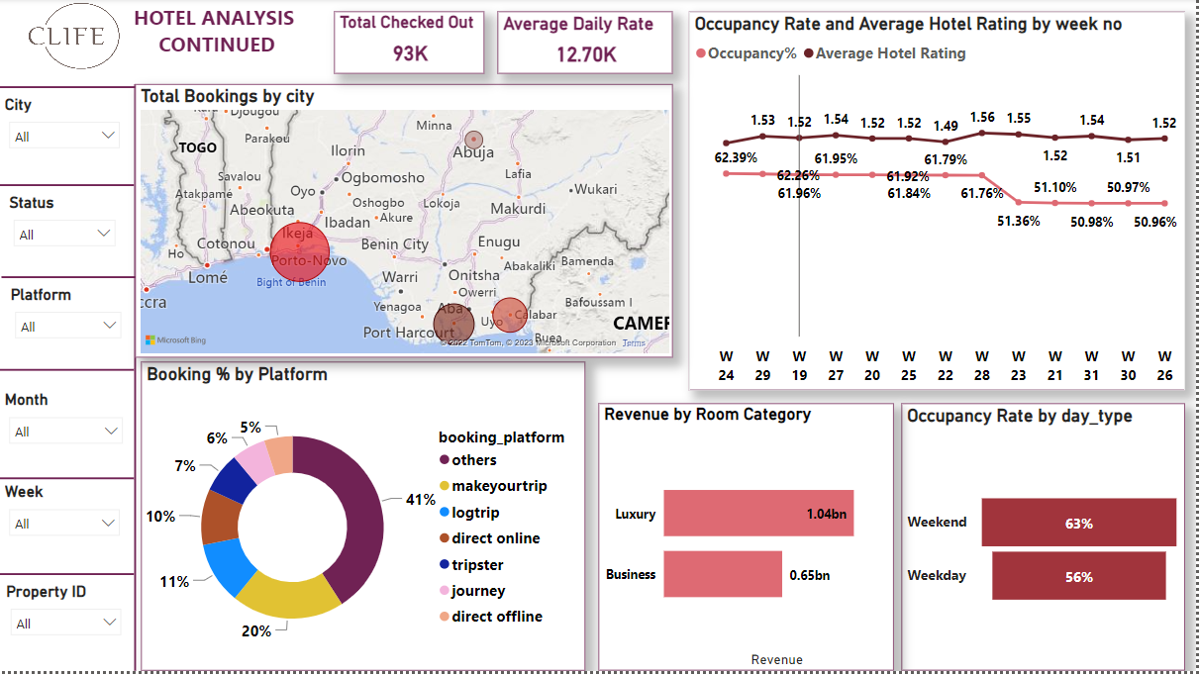
VISUALIZATION

Slide 9
INSIGHTS
Split by City
Ratings:
The chart shows that Hotels in Abuja have the highest ratings with value of 1.6 , this is followed by Lagos and Port Harcourt which had rating values of 1.5 respectively.
Occupancy %:
Occupancy is the total successful bookings to the total rooms available(capacity). With 60%, Abuja recorded the highest occupancy rate, followed by Port Harcourt and Lagos which had 57.98% and 57.83% respectively.
Revenue:
On the basis of revenue generated by each city, Lagos recorded the highest revenue with a value of 661 million naira. In spite of having high ratings and occupancy rate, Abuja had the least revenue turnover with a value of 291 million naira.
The Overall Rating of the Clife Hotel was 1.52 which is quite low, and the Total Revenue generated by the hotel is 1.69 billion naira.

Slide 10
INSIGHTS
Hotel Properties by Key Metrics
Ratings:
Clife Blu had the highest ratings value of 1.66. Clife City and Clife Palace had the second highest rating of 1.57 respectively. The hotel with the least rating was Clife Seasons with a value of 0.96.
Total Successful Bookings:
Clife Palace, Clife Exotic and Clife City recorded the highest number of successful bookings, while Clife Seasons had the least amount of successful bookings.
Occupancy Rate vs Cancellation Rate:
For the period of May to July 2022, Clife Blu had the highest occupancy rate and lowest cancellation rate values being 71.51% and 28.49% respectively. Clife Seasons recorded the highest amount of cancellation with value of 35.76%, seconded by Clife Grands which had 32.33%.
Revenue:
Clife Exotica generated the highest revenue with value of 316 million naira, followed by Clife Palace 300 million and Clife City 282 million naira. Although Clife Blu had the highest rating and occupancy rate, it total revenue was 258 million making it the fourth hotel with high revenue generation.
The hotel with the least revenue generation was Clife Season with a turnout of 65 million naira.

Slide 11
INSIGHTS
Total Bookings by City
Lagos had the highest number of total bookings with a value of 42941, seconded by Port Harcourt 34454. The city with the least number of booking was Abuja , value being 23927.
Occupancy Rate and Average Rating by Week no
The week with the highest rating was week 28 with rating value of 1.56 and occupancy rate of 61.76%. Week 22 had the least rating with a value of 1.49 and occupancy rate of 61.79%.
For occupancy rate, week 24 recorded the highest occupancy rate
With a value of 62.39% and rating of 1.48. The week with the least occupancy rate is week 26 with occupancy of 50.98% and rating of 1.52.
Booking by Platform
The chart shows that 41% of the booking was done through other channels, 20% was done through Make your Trip, 11% through Logtrip and 10% through direct online request amongst others. Also the least used platform is journey which had 5%.
Booking by Room Category
Amongst the room category, the Luxury room sold more and it generated a revenue value of 1.04 billion naira. Where as the business category generated 647,733 million naira.
Occupancy Rate by Day Type
When comparing the occupancy rate based on different day types(weekdays and weekend). The weekend recorded occupancy rate of 63%, while weekday had 56%. This shows that more people patronize the hotel on weekends

Slide 12
RECOMMENDATION
The following are recommendations for reclaiming market share and improving revenue of Clife Hotels.
1. Offer charges for premium services like early check-in and late checkout. This is one of the simplest way to increase revenue of the hotel. Although it may be tedious allowing guests check-in early or checkout late if occupancy is high, the use of guest management hospital software can help tackle this problem.
2. Partner with local businesses to offer excursions and experiences to leisure guests. This is an efficient way of increasing revenue, as you can offer services of local businesses to your clients at discounted rates. The business will then pay you a commission or a referral fee after your guest purchases their excursions or experiences.
3. Increase and improve your ratings and reviews
90% of guests check hotel ratings prior to booking a stay. Making sure that your hotel has great reviews online is critical to increasing revenue at your hotel. Increase staff focus on hospitality by ensuring effective communication with guests before, during and after their stay. Ensure seamless and convenient performance of Booking Platforms as this will encourage them to leave a positive review after their stay.
4. Take advantage of other upsell opportunities like Parking Fees, Pet Fees, Shuttle Transportation, and Retail or Gift Store.
5. In addition to offering early check-in and late checkout, offer room upgrades pre-arrival.

Slide 13
THANK YOU!

